Slide 1
Workshop #1
Fall Recap and Moving Forward

Slide 2

What is/isn’t data science?

Slide 3
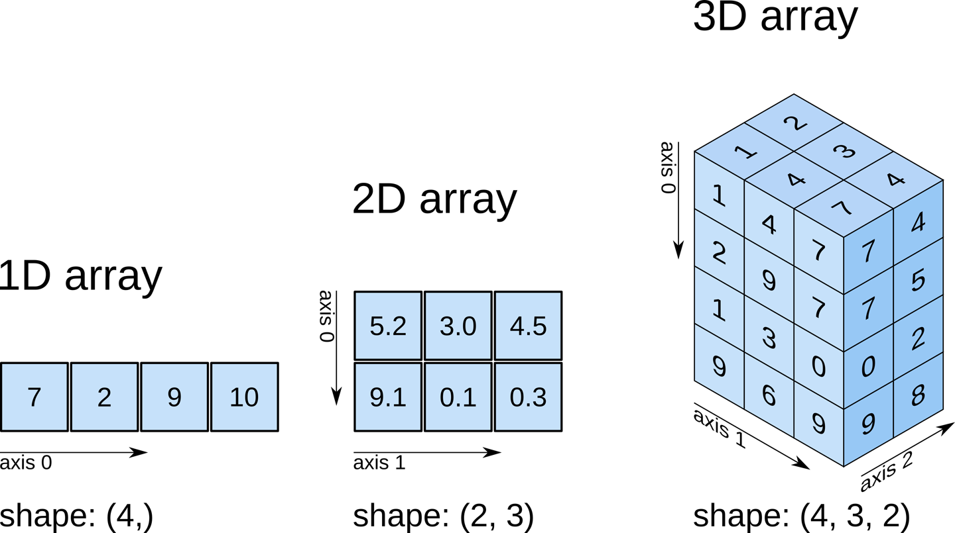
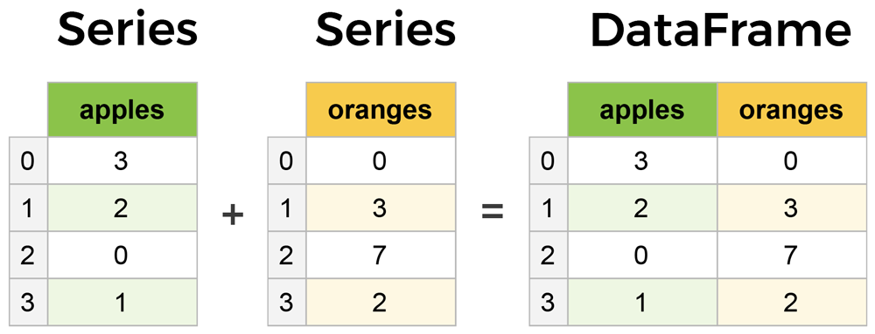
Python - Numpy, Panda, Matplotlib

Slide 4
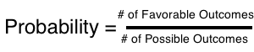
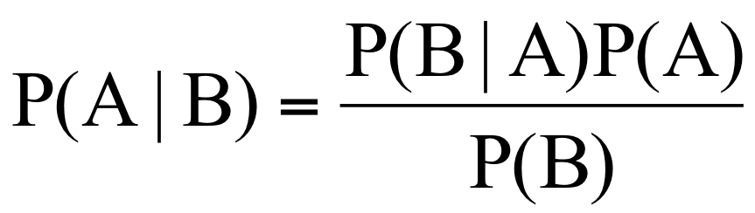
Some Probability
Basic Probability
Likelihood a particular event will occur out of the possible ones that can occur.
Conditional Probability
Probability an event will occur given another event has. Can be calculated using Bayes’ Theorem
Independence & Mutual Exclusivity
Two events are independent if A occurring doesn’t impact the likelihood of B occurring.

Slide 5

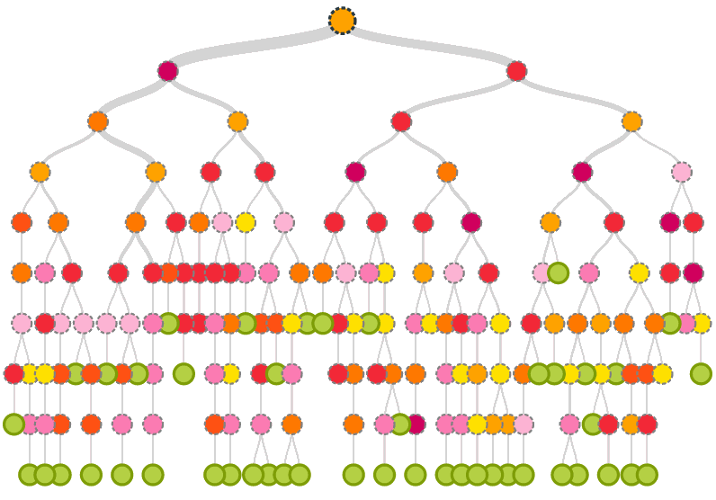
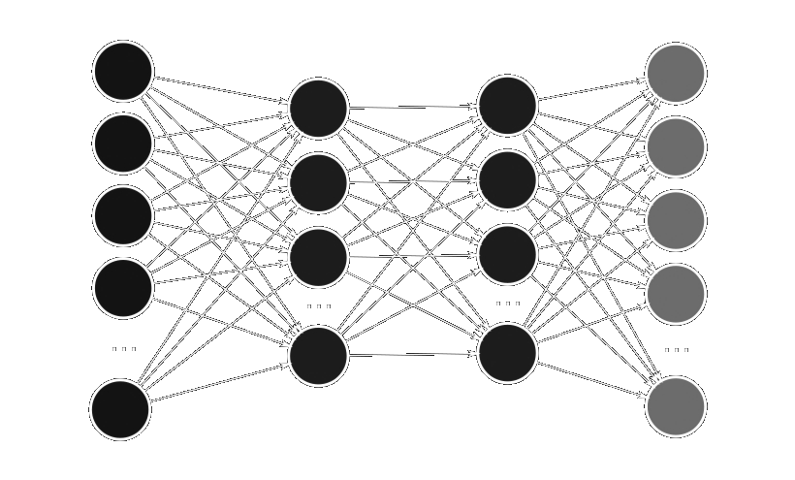
Three ways to consider models
Pictorial Representation
Decision Boundaries
Math Formulation
Jellyfish

Slide 6
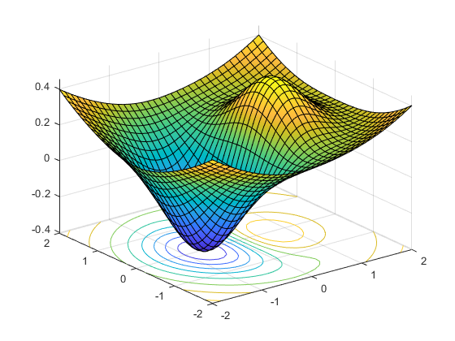
Optimization

Slide 7
Clustering

Slide 8
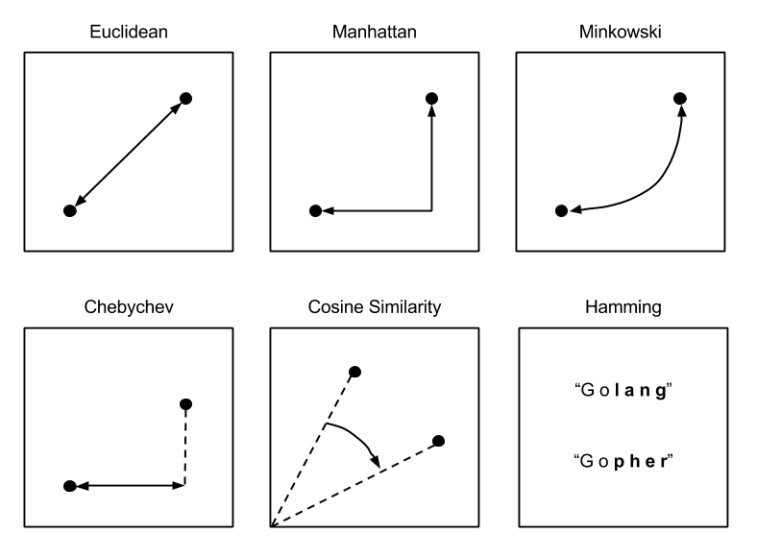
Distance Metrics

Slide 9
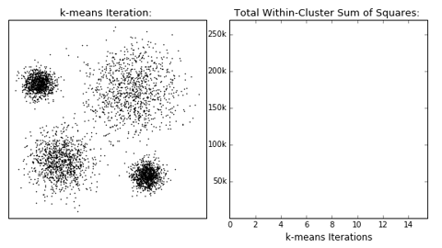
K-means Clustering
Steps
Decide on K centers
Initialize K centers
Assign points to the nearest centers
Move center towards mean
Recompute distances
Reassign clusters
Move centers
Halt when no change. Converged!

Slide 10
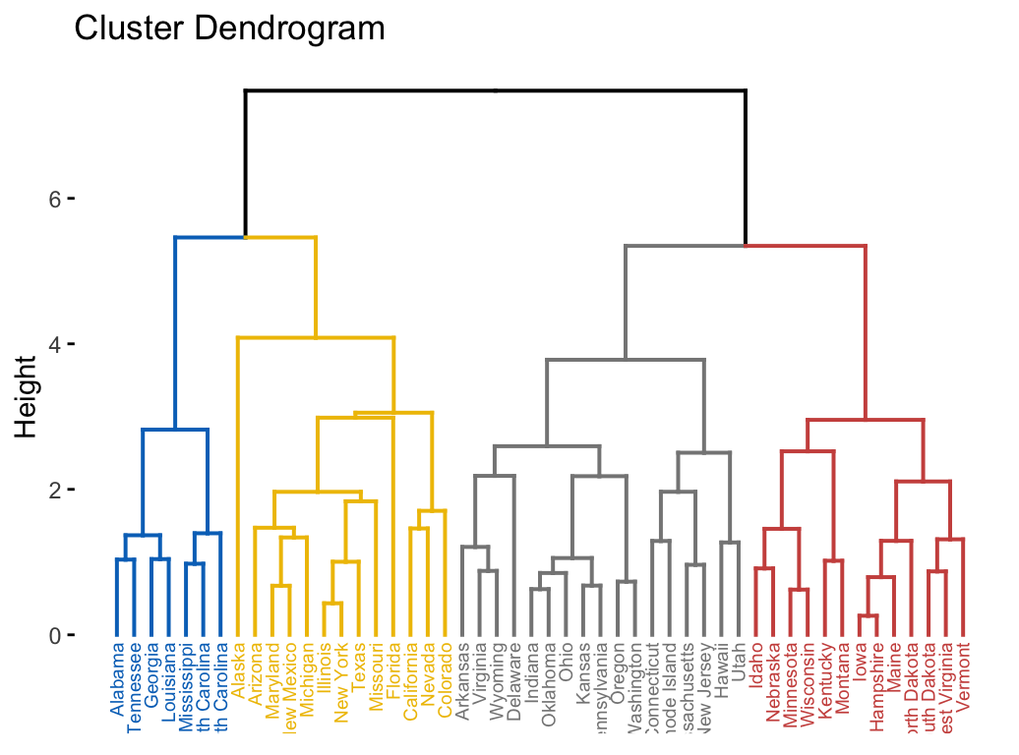
Hierarchical Clustering
Steps
Compute distances between all points/clusters
Place into proximity matrix
Find closest pair
Merge
Repeat 1-4 until only one point/cluster exists

Slide 11
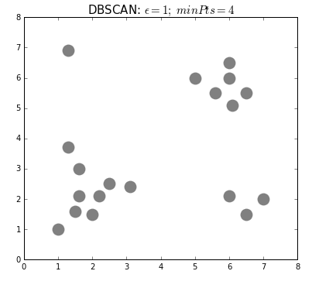
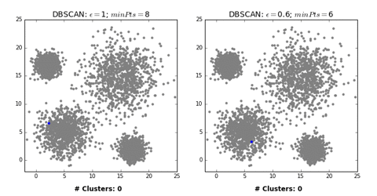
DBSCAN - a density-based clustering

Slide 12
Regression

Slide 13
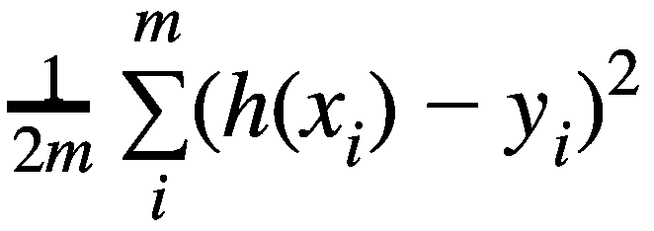
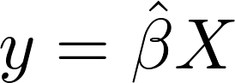
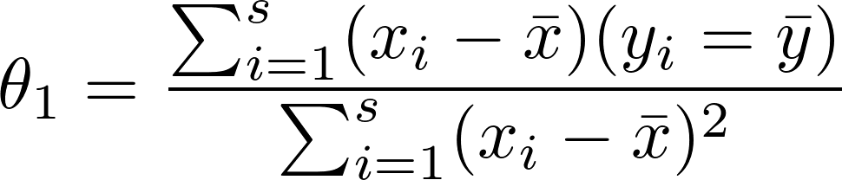
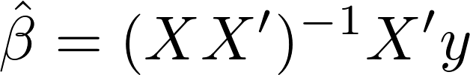

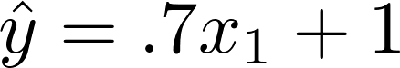
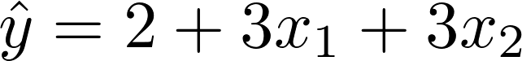
Regression
Simple Linear
Least Squares
Gradient Descent
Directly estimate intercept and slope
Usable only with one feature
Linear Algebra Approach
Slow on large datasets
Optimizer approach
Better for large datasets

Slide 14
Dimensionality Reduction

Slide 15
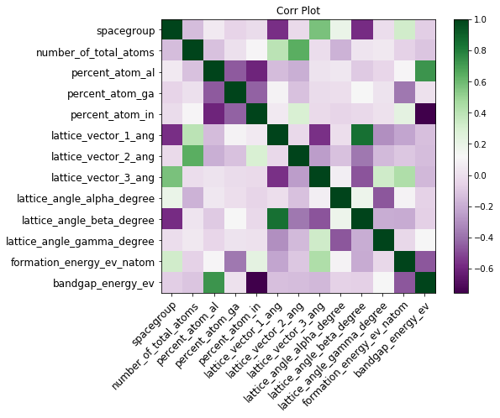
Forward Feature Selection
Steps
Iterate through all features
Select most informative feature
Keep it
Iterate through all other features
Select best compliment
Iterate through remaining features
Select best compliment
Terminate at threshold

Slide 16

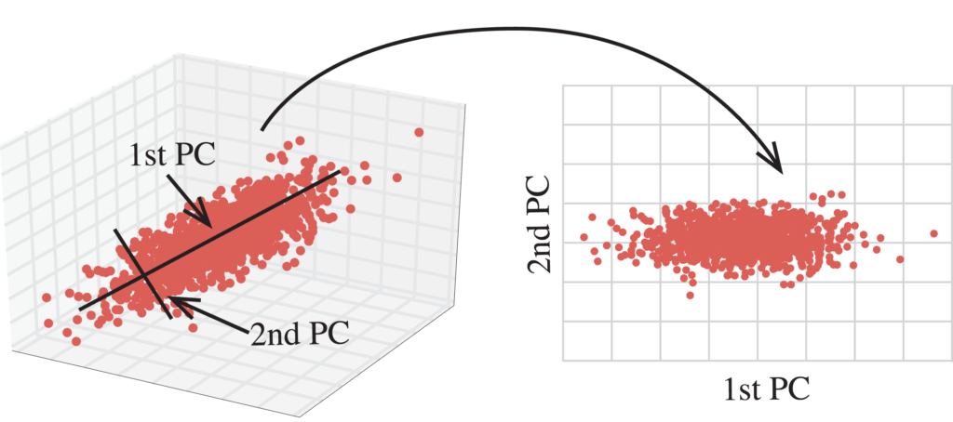
Principal Component Analysis (PCA)

Slide 17
SVMs

Slide 18
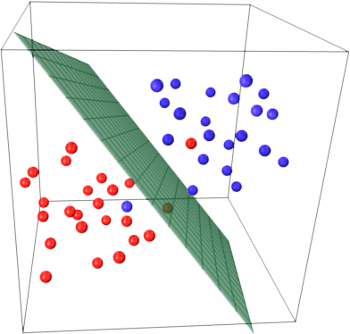
A hyperplane as boundary

Slide 19
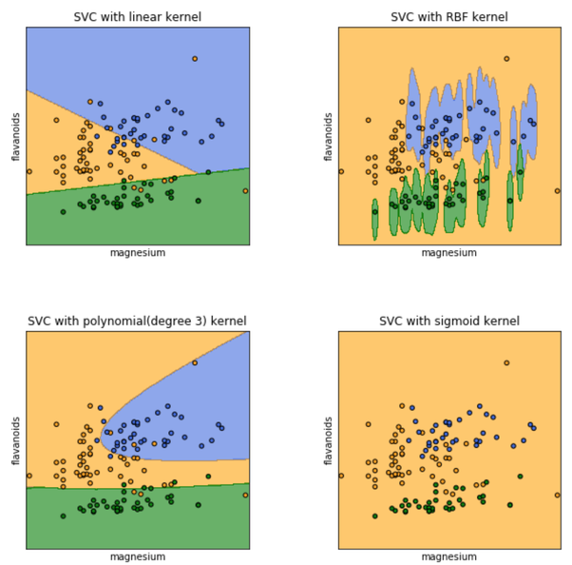
Kernel
Transform data into another space where it is separable by hyperplane
Linear kernel
Radial Base Function (rbf) kernel
Polynomial kernel
Sigmoid kernel

Slide 20
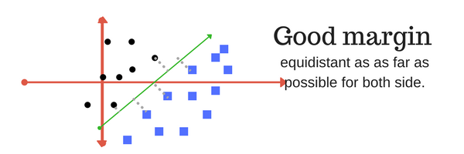
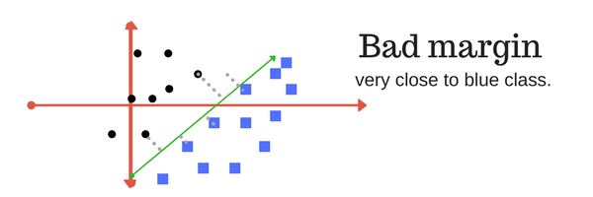
Margin

Slide 21
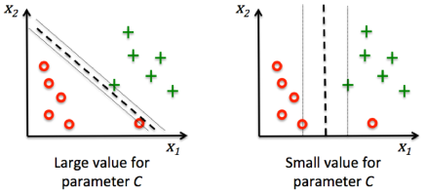
Regularizer / Penalty / C
How much we want to avoid (or penalize) misclassification
Large C
Prioritize smaller-margin hyperplane
Even if boundary is more complicated.
Small C
Look for a larger-margin hyperplane
Even if it mis-classifies more points

Slide 22
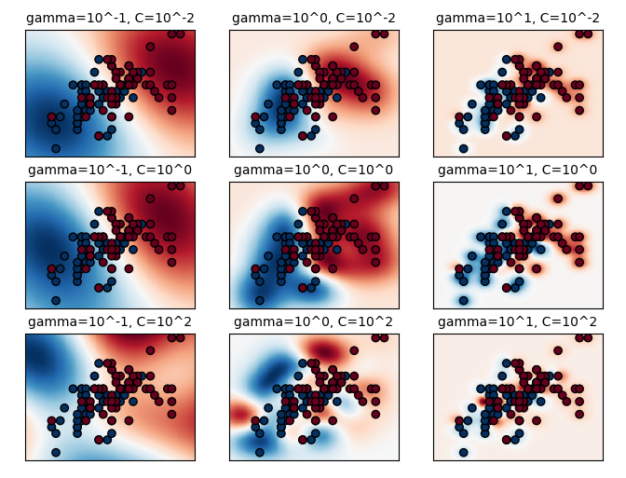
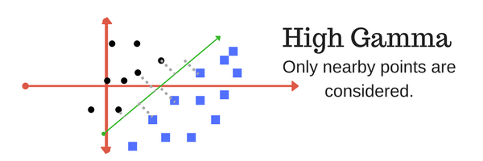
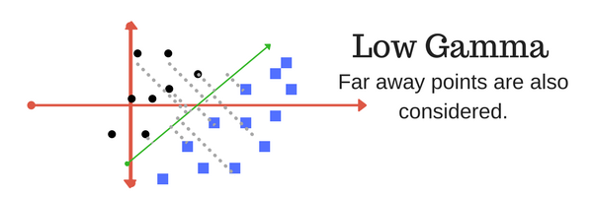
Gamma
How far can a single point influence our boundary calculation

Slide 23
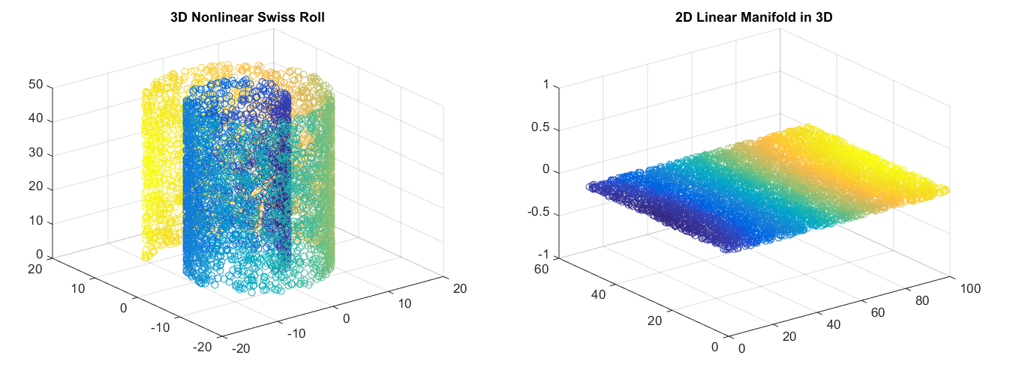
Shortcoming

Slide 24
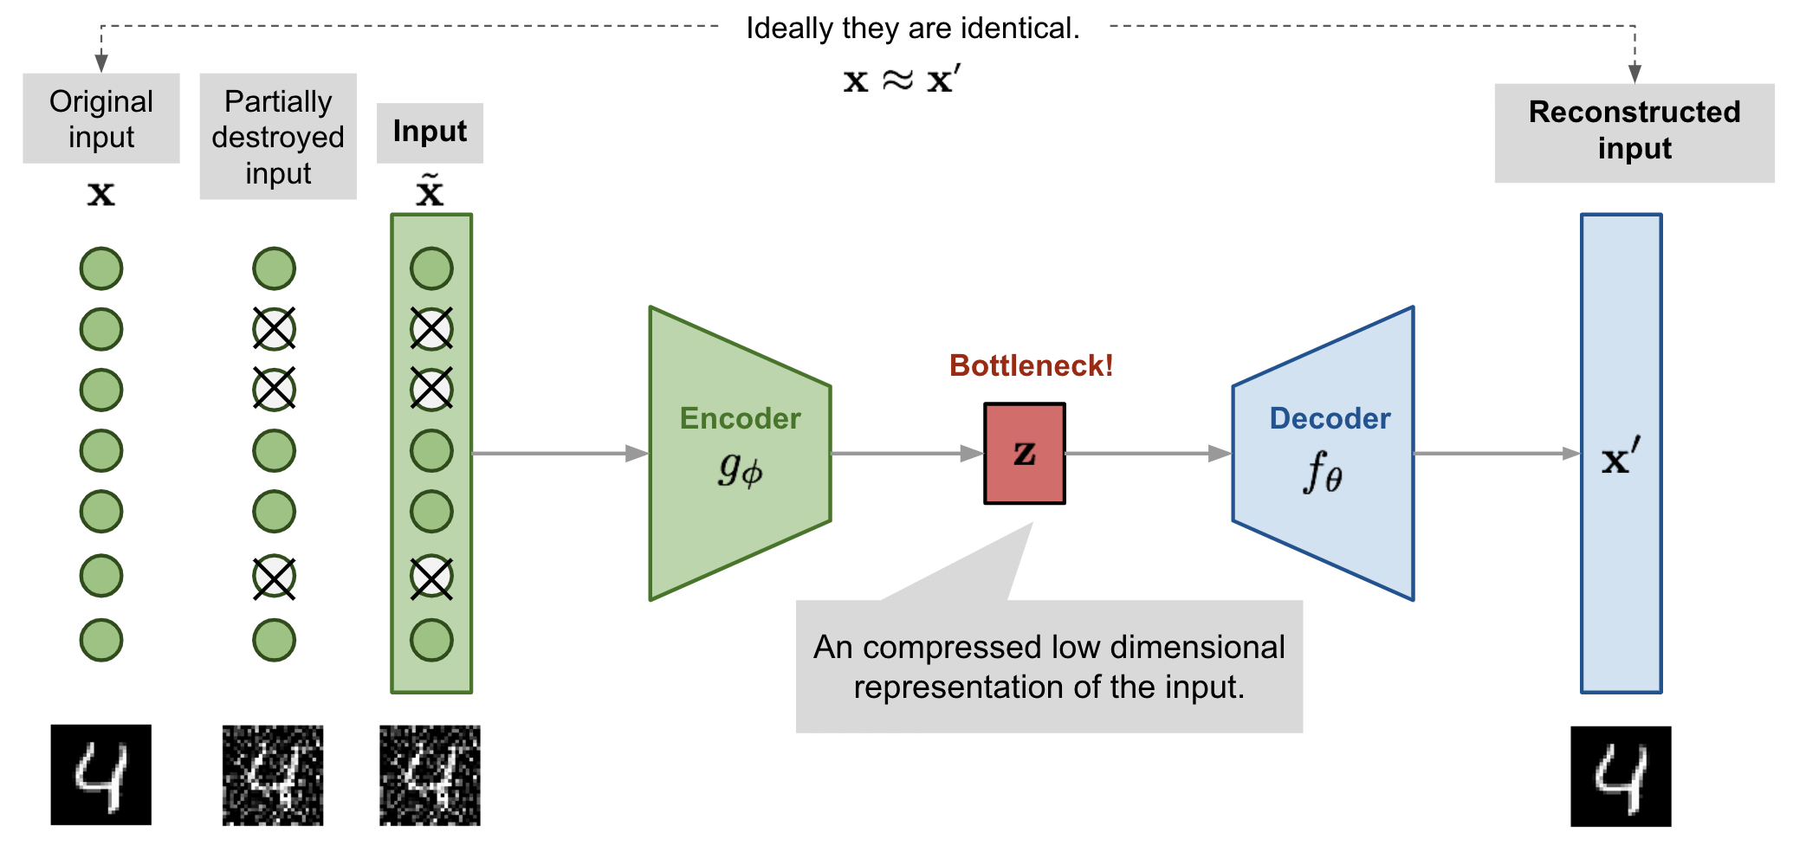
Autoencoder

Slide 25
Random Forest, Decision Trees,
&
Ensemble Methods

Slide 26
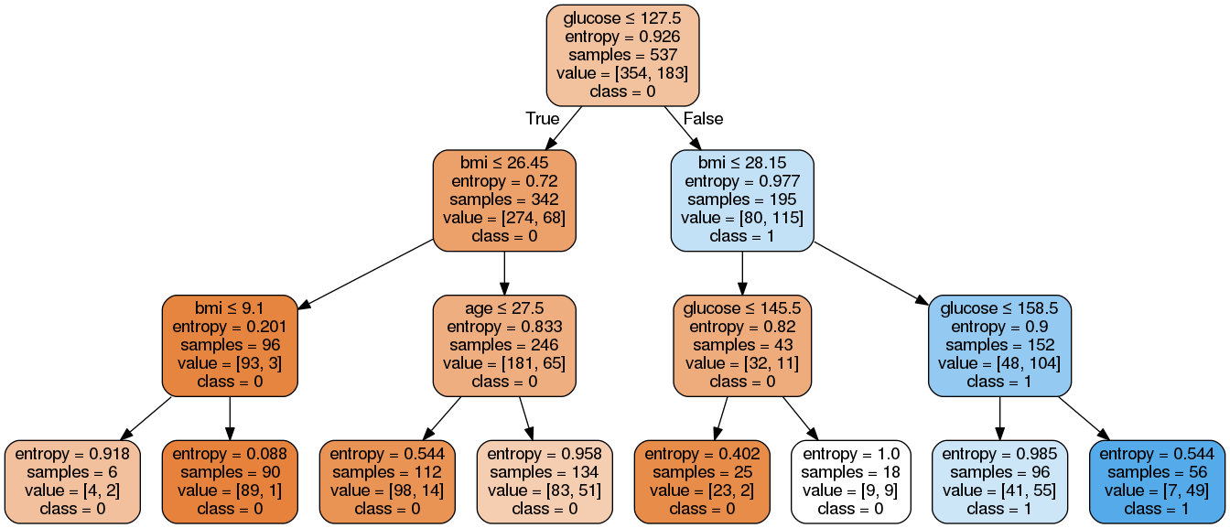
Algorithm
Calculate entropy of target
Calculate entropy for each branch
Choose attribute with largest information gain
Repeat

Slide 27
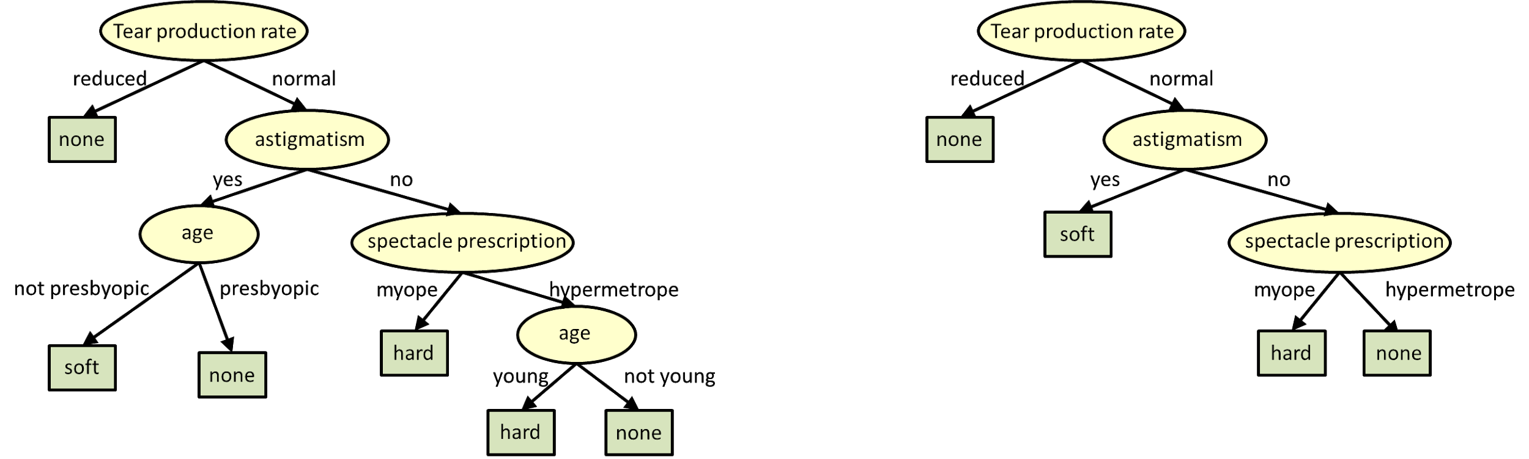
Pruning

Slide 28
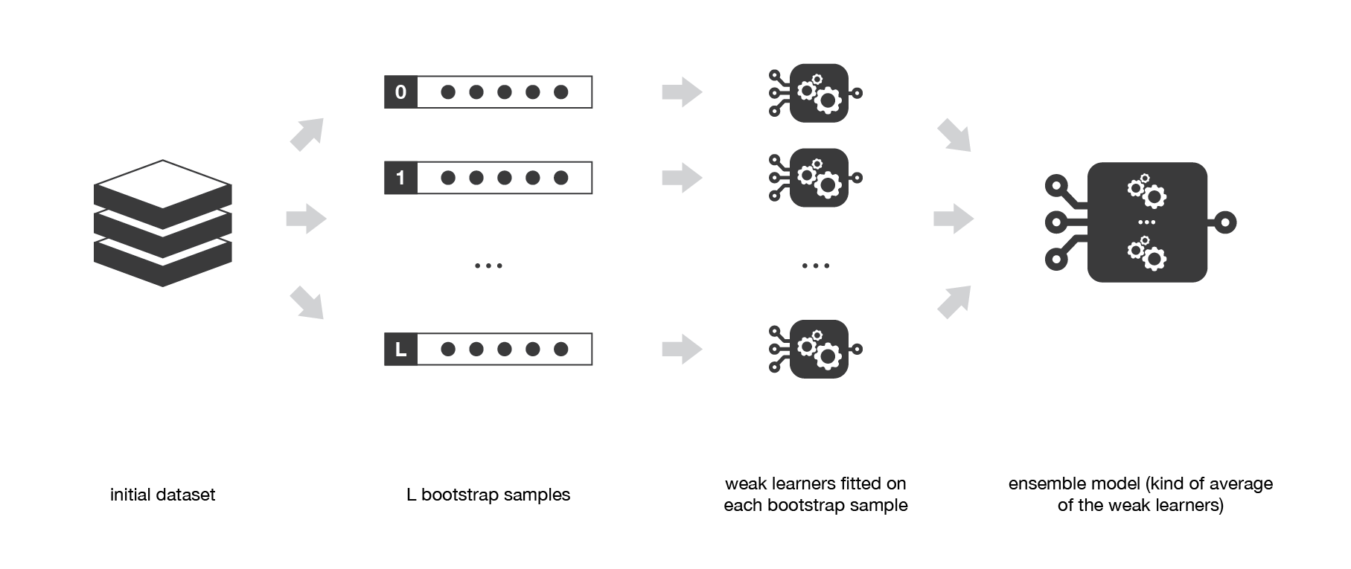
Bagging

Slide 29
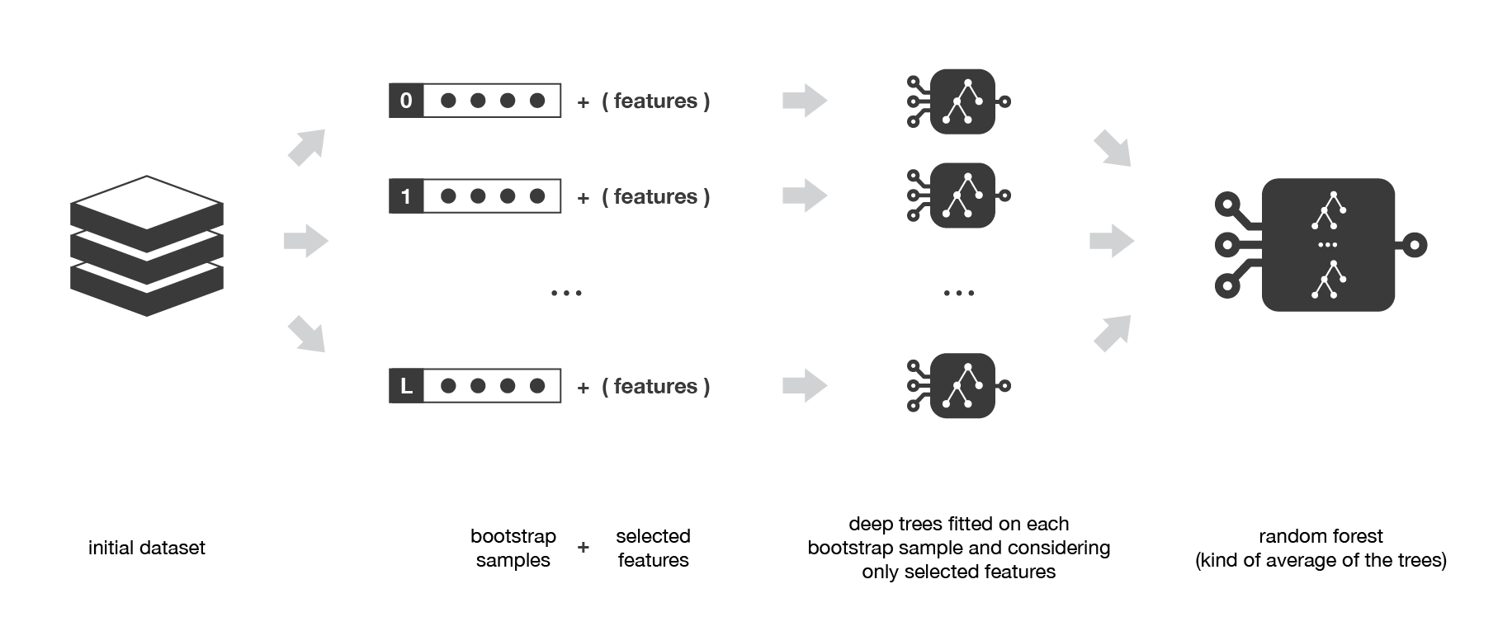
Random Forest: Bagging + Feature Sampling

Slide 30
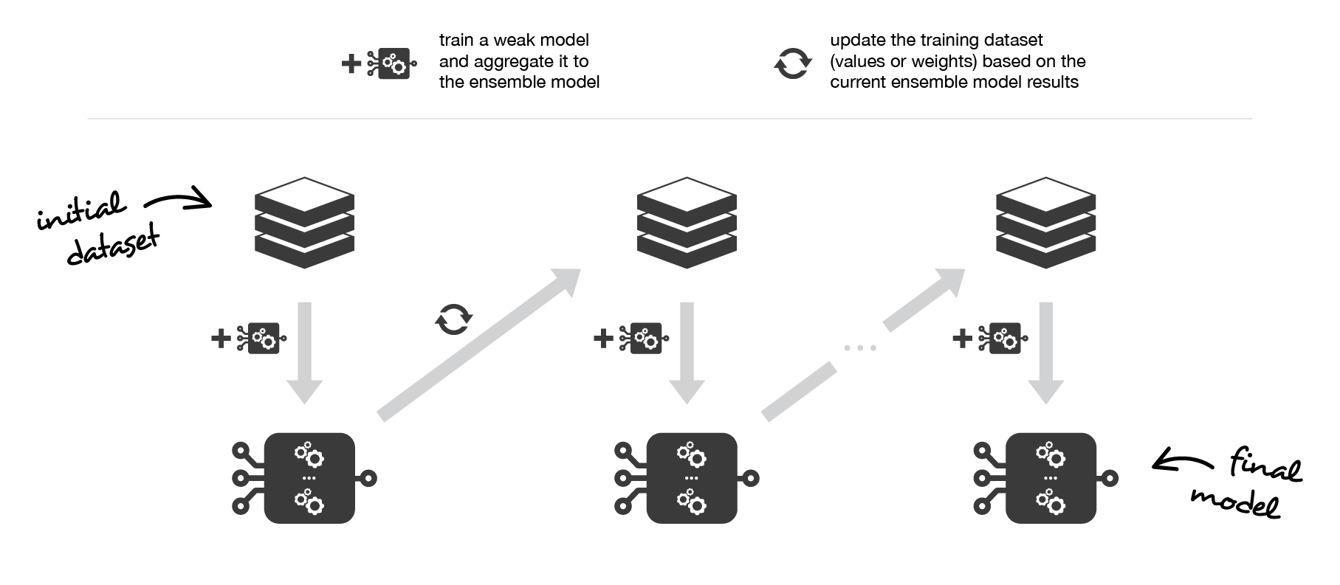
Boosting
Sequential models trained upon results of the previous classifiers
Tells the next model which data points are difficult to classify (mis-classified ones)

Slide 31
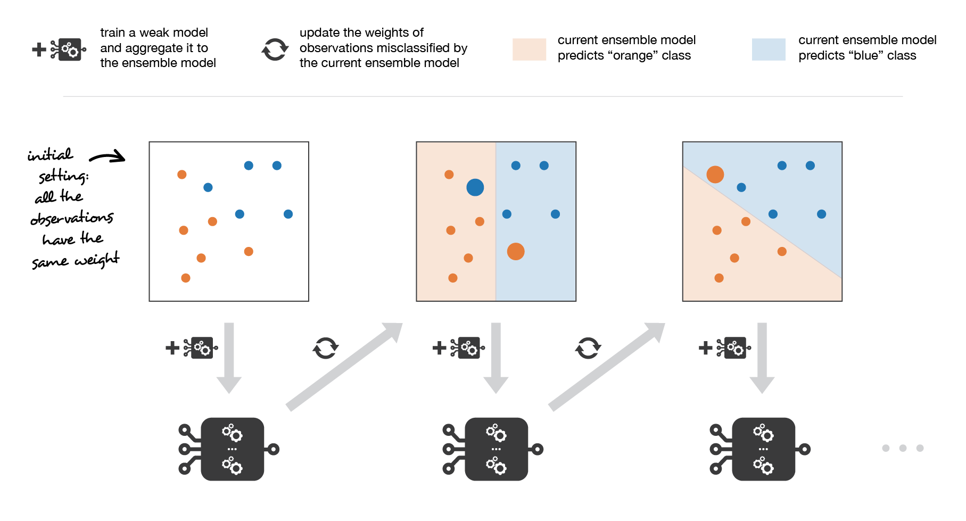
Adaboosting: Adaptive Boosting

Slide 32
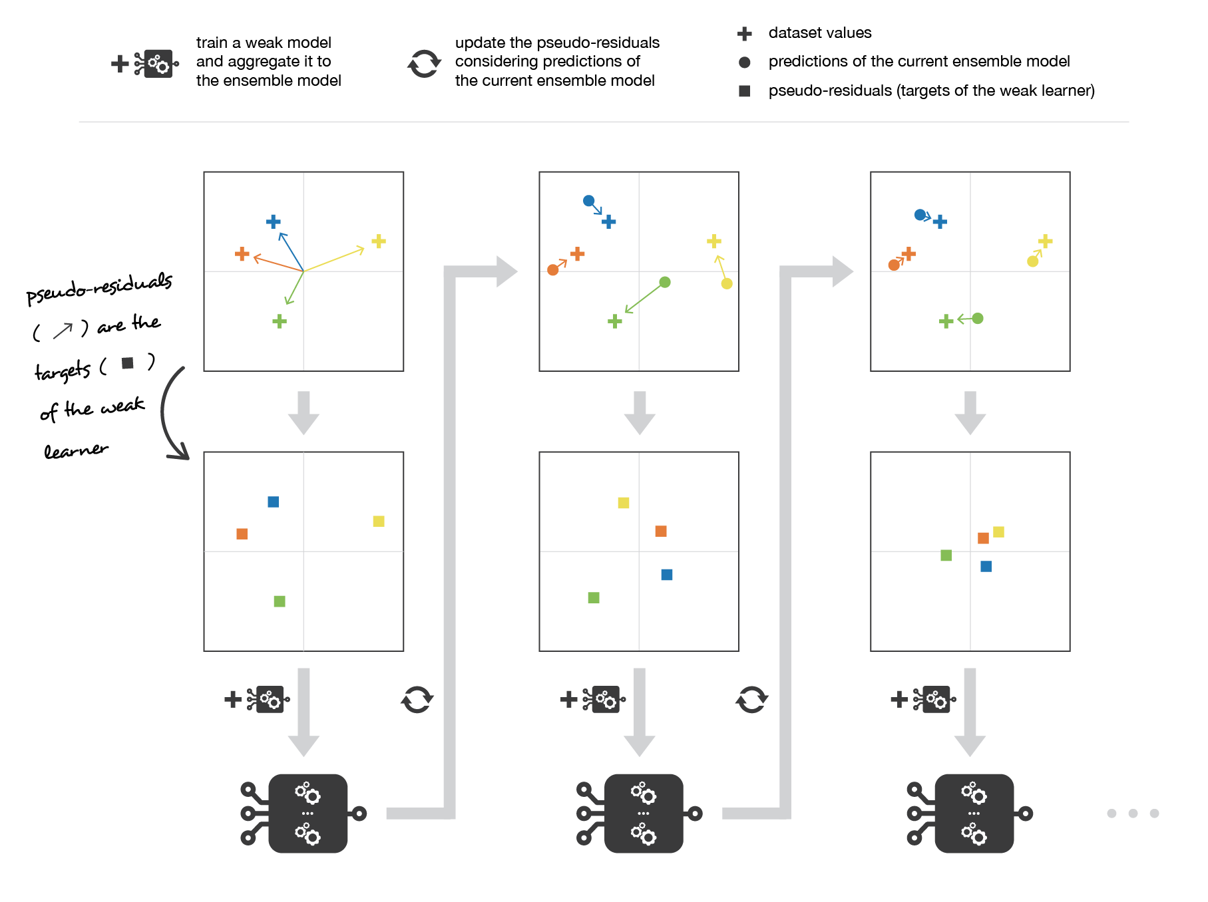
Gradient Boosting

Slide 33
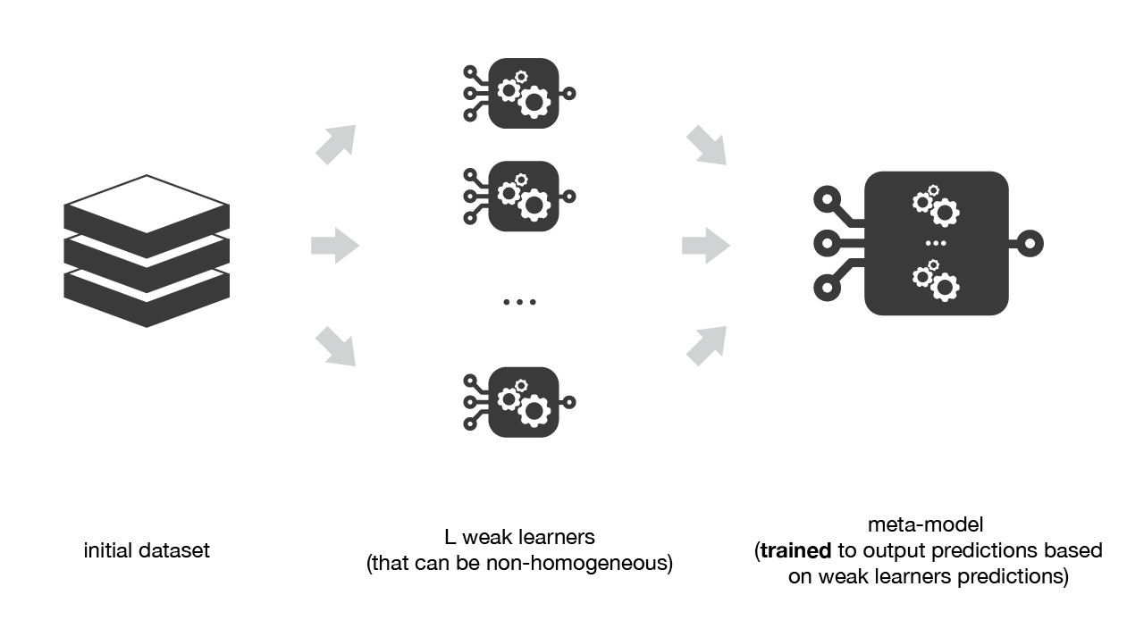
Stacking

Slide 34
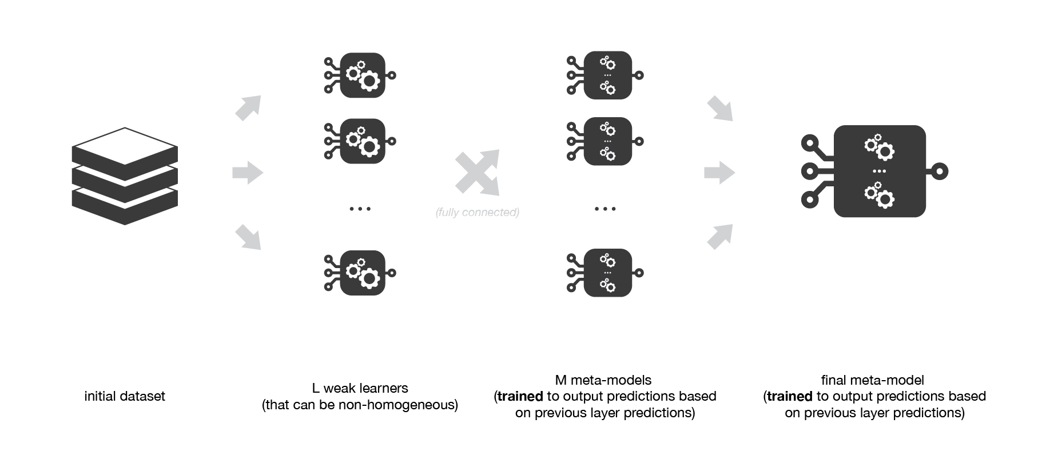
Also Stacking

Slide 35
Markov Chain

Slide 36
Sunny
7%
Rainy
Cloudy
30%
60%
Windy
3%

Slide 37
60%
Sunny
30%
10%
70%
30%
10%
Rainy
Cloudy
60%
10%
10%
Windy
25%
10%
25%
50%

Slide 38
Instead….
 | Rainy | Sunny | Cloudy | Windy
Rainy | 60% | 0% | 30% | 10%
Sunny | 0% | 60% | 30% | 10%
Cloudy | 10% | 10% | 70% | 10%
Windy | 0% | 25% | 25% | 50%

Slide 39
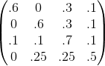
Instead… Markov Chain!

Slide 40
Properties
Properties of Markov Chains
Stochastic
Memoryless
Discrete-time & continuous
Embedded Chains
Steady States
Reducibility
Reversibility, Regularity
Properties of States
Periodicity
Recurrence
Transience
Absorbing States

Slide 41
Periodicity
The chain is visited every n steps
 | Rainy | Sunny | Cloudy | Windy
Rainy | 0 | 0 | 1 | 0
Sunny | 0 | 0 | 1 | 0
Cloudy | 0.5 | 0.5 | 0 | 0
Windy | 0 | 0 | 0 | 1

Slide 42
Recurrence
We will, for sure, return to this state eventually.
 | Rainy | Sunny | Cloudy | Windy
Rainy | 0.5 | 0.5 | 0 | 0
Sunny | 0 | 0.5 | 0.5 | 0
Cloudy | 0 | 0 | 0.5 | 0.5
Windy | 0.5 | 0 | 0 | 0.5

Slide 43
Transience
Non-zero probability we will NEVER return (opposite of recurrence)
 | Rainy | Sunny | Cloudy | Windy
Rainy | 0.5 | 0.5 | 0 | 0
Sunny | 0 | 0.5 | 0.5 | 0
Cloudy | 0 | 0 | 0.5 | 0.5
Windy | 0 | 0 | 0 | 1

Slide 44
Absorbing States
The Markov chain "stops" here.
 | Rainy | Sunny | Cloudy | Windy
Rainy | 0.5 | 0.5 | 0 | 0
Sunny | 0 | 0.5 | 0.5 | 0
Cloudy | 0 | 0 | 0.5 | 0.5
Windy | 0 | 0 | 0 | 1

Slide 45
Steady States
Limiting distribution of a markov chain. Equal to the normalized eigenvector with eigenvalue 1. Eigenvector must be:
Positive
Nonzero

Slide 46
Statistics

Slide 47
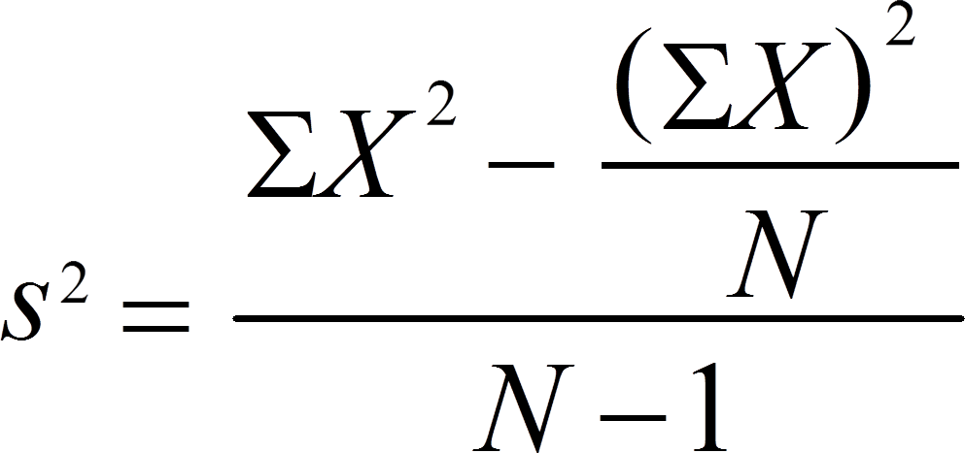
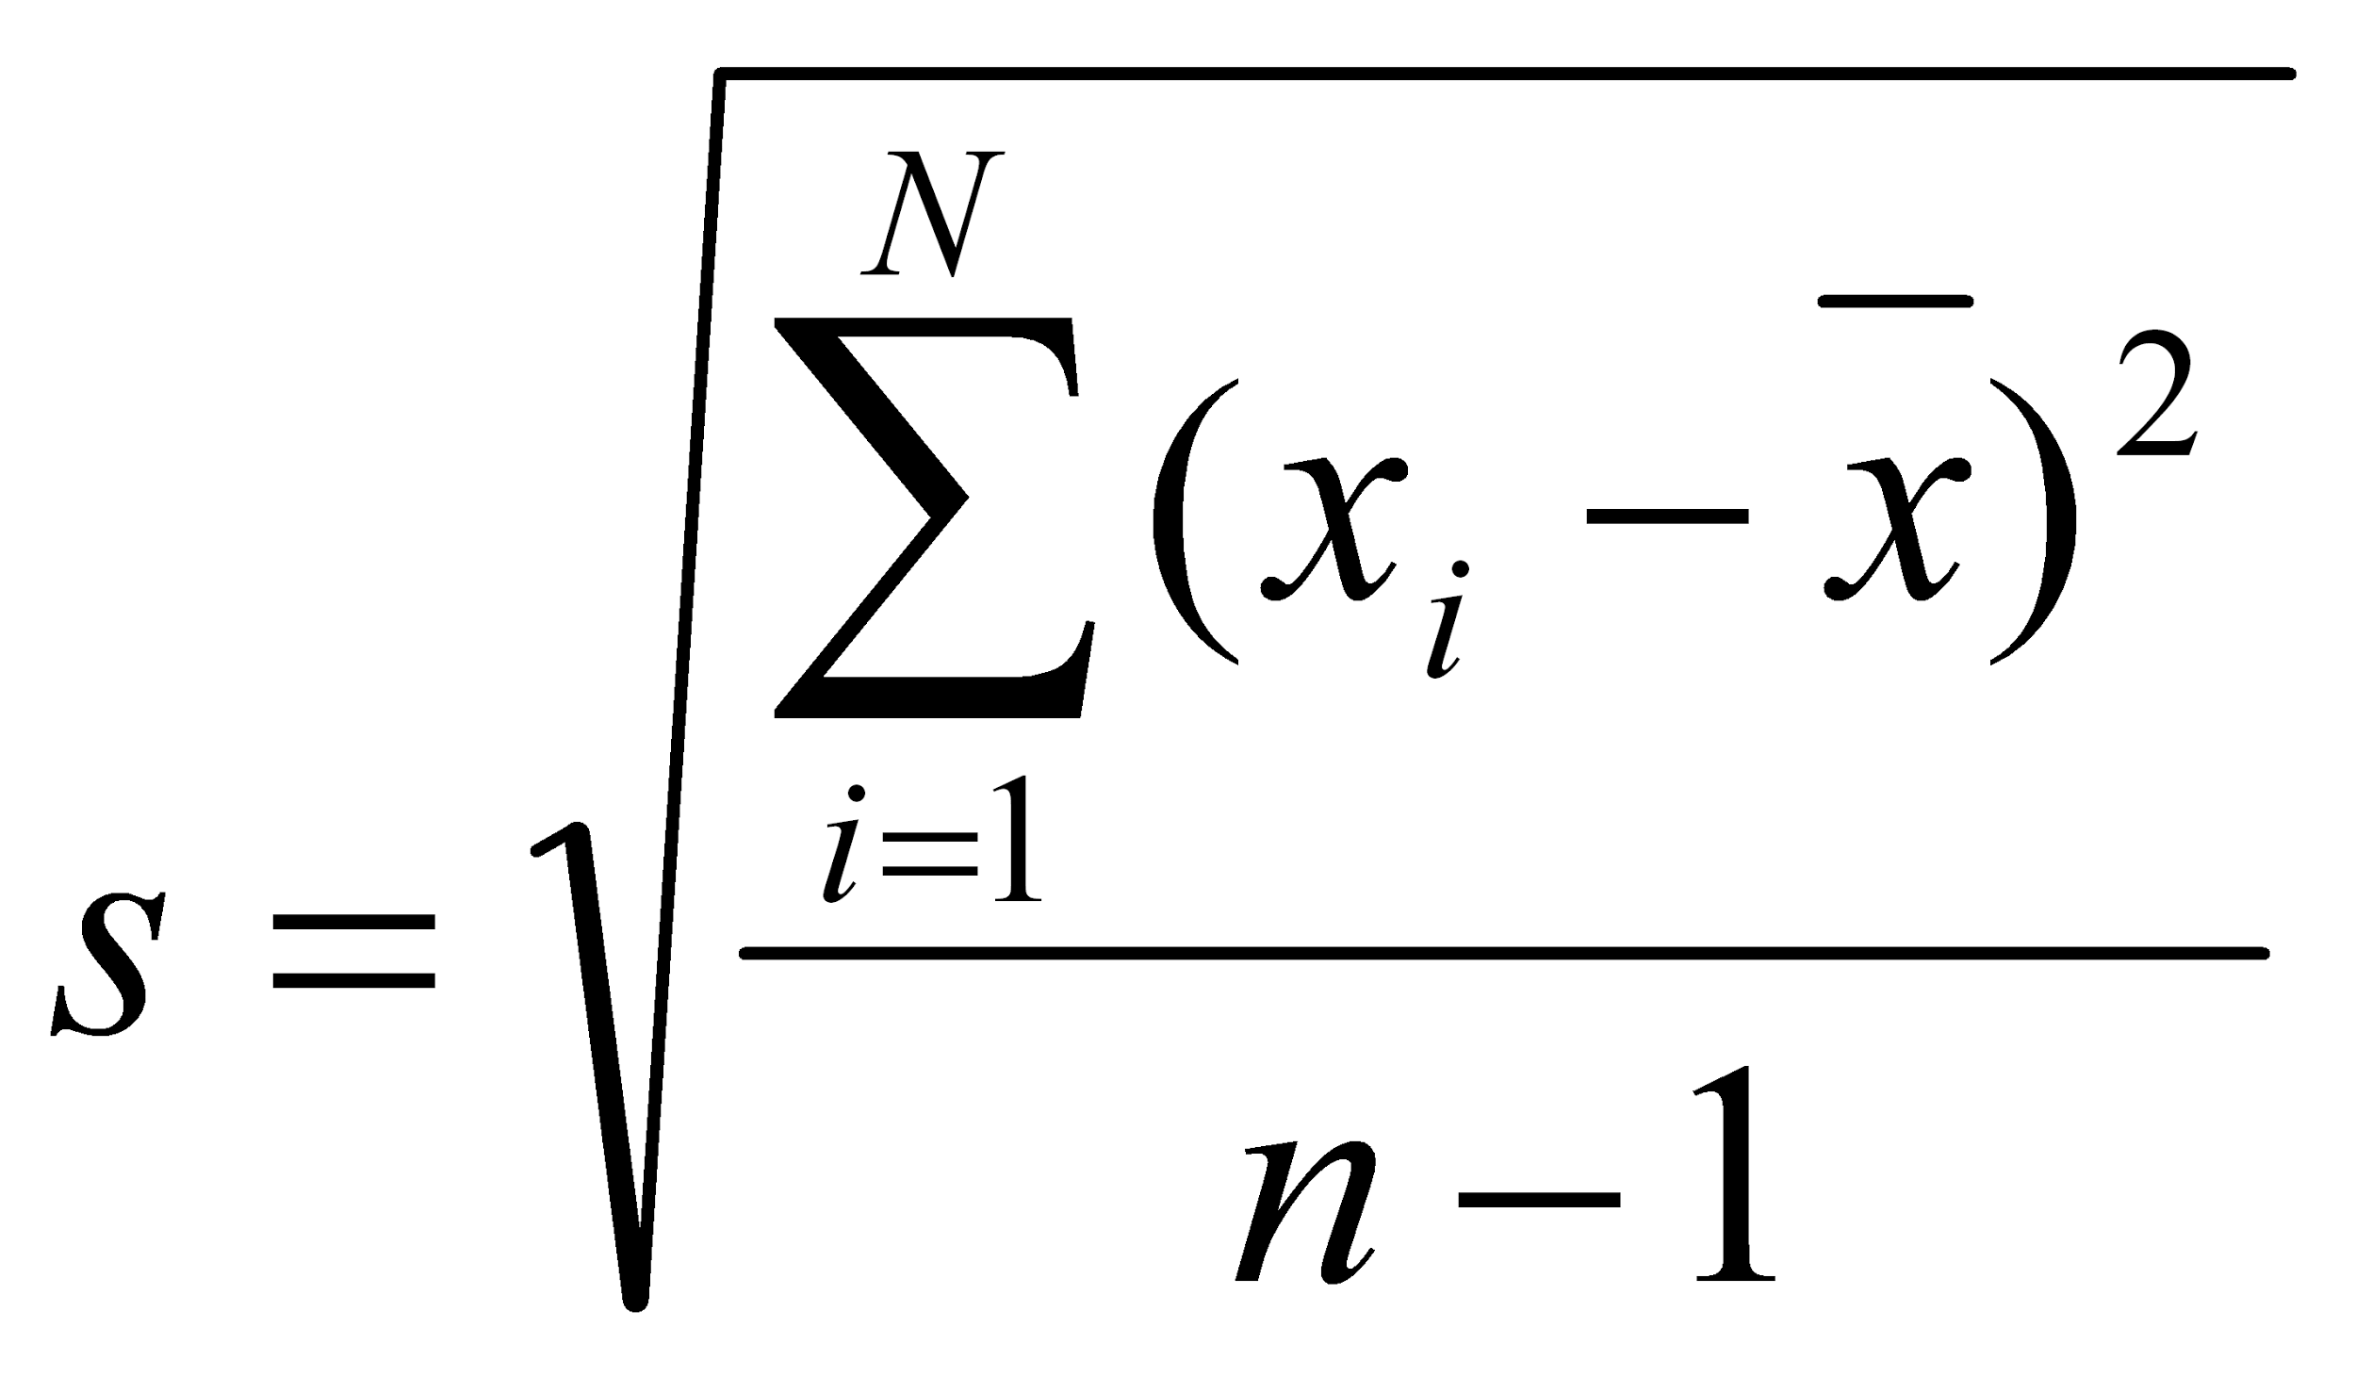
Descriptive Statistics
Central Tendency Measures
Mean
Median
Mode
Variability Measures
Range
Variance
Standard Deviation

Slide 48
Central Limit Theorem (CLT)
Distribution of sample approximates a normal distribution if sample size is large enough!
Animation: https://seeing-theory.brown.edu/probability-distributions/index.html

Slide 49
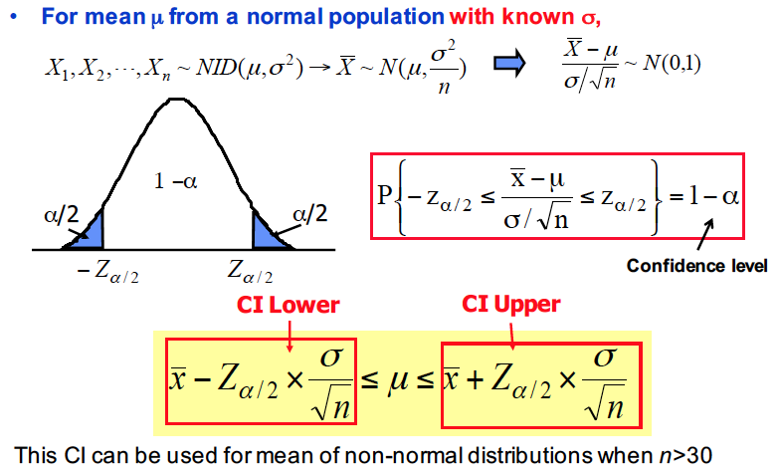
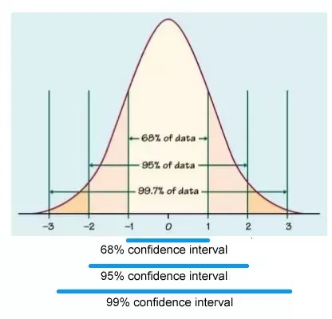
Confidence Interval (CI)
A bound on the estimate of a population variable such as the mean or the variance.
Smaller CI: More precision
Larger CI: Less precision

Slide 50
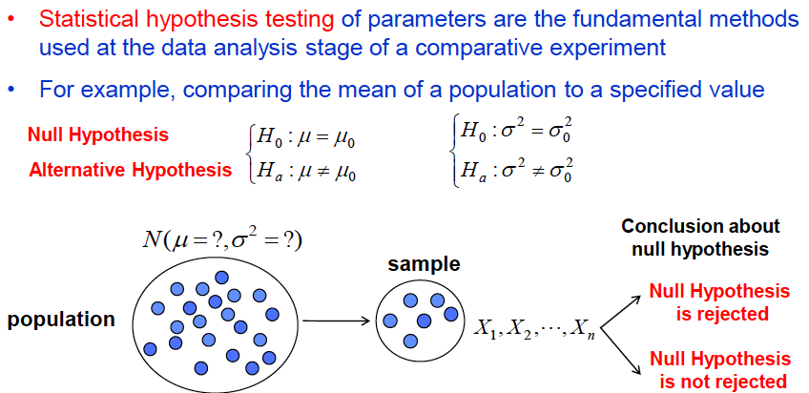
Hypothesis Testing

Slide 51
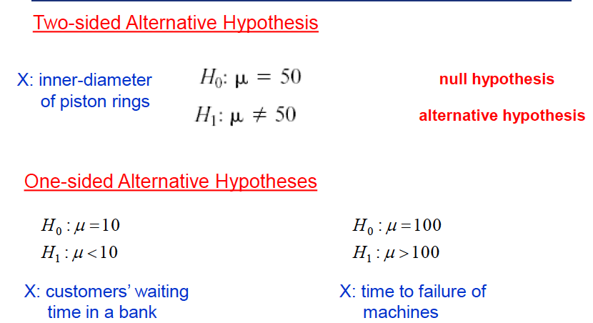
Hypothesis Testing - Types

Slide 52
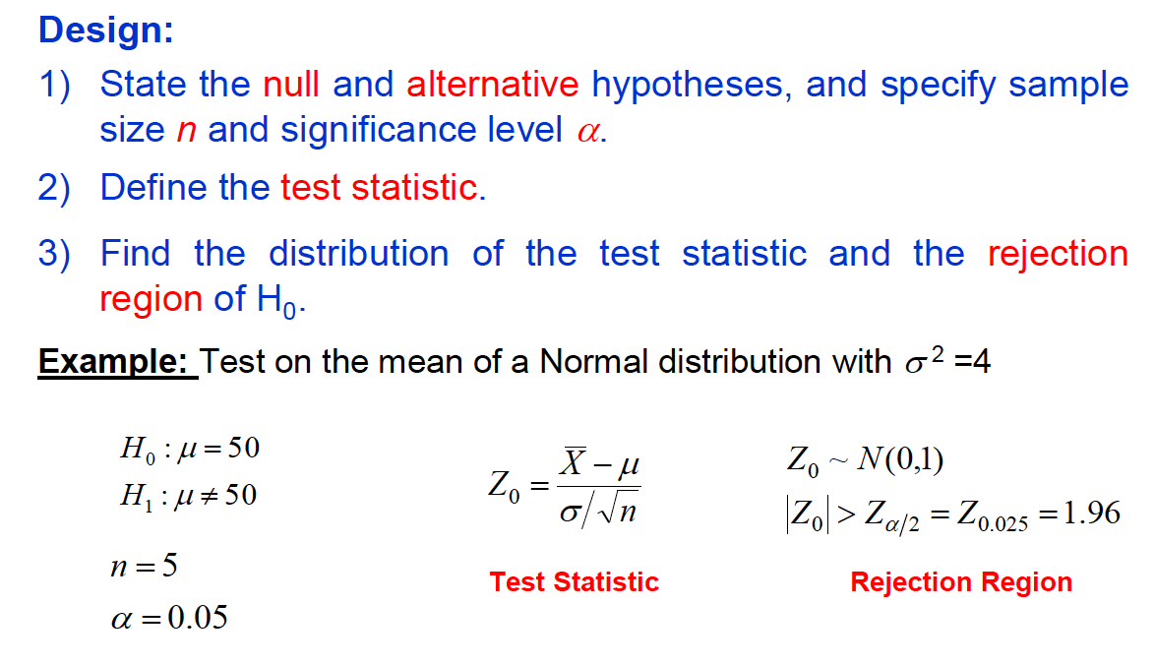
Hypothesis Testing - Steps

Slide 53
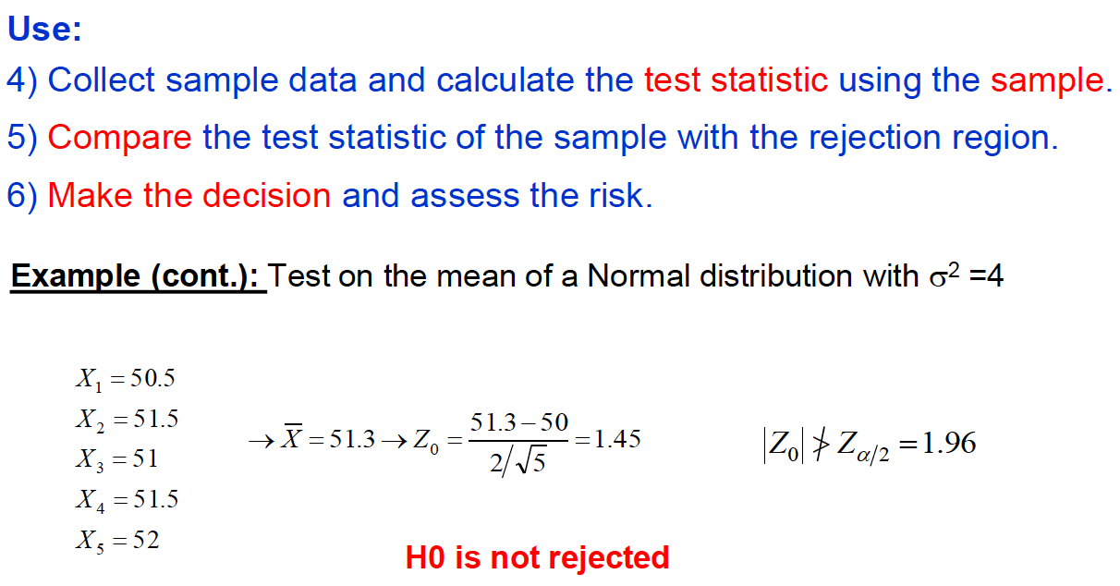
Hypothesis Testing - Steps

Slide 54
Natural Language Processing

Slide 55
Sentence Segmentation
Break the text apart into separate sentences
Can be as simple as splitting a string by spaces or punctuation marks
Modern NLP pipelines often use more complex techniques to handle irregular formatting
“There are bakeries in France. The bakers speak French. They sell bread.”
There are bakeries in France.
The bakers speak French.
They sell bread.

Slide 56
Word Tokenization
Process each sentence at a time and break into tokens
Need not just be words
In English, however, we split by space and include punctuation marks as separate tokens.
“London is the capital and most populous city of England and the United Kingdom.”
………..
London
is
the
United
Kingdom

Slide 57
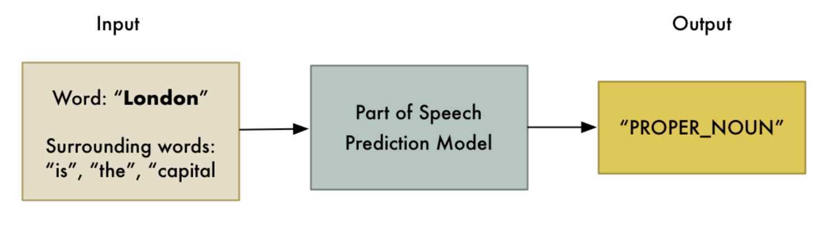
Parts of Speech Tagging
Assess each token’s role in a sentence by feeding into pre-trained part-of-speech classification model.
Completely statistical. Does not understand inherent meaning the way humans do.

Slide 58
Text Lemmatization
Words appear in different forms.
“I had a pony.”
“I had two ponies.”
Both talking about ponies, but using different inflections! Helps to know the base form of each word.
This is known as lemmatization: figuring out the lemma of each word in the sentence.
I have a pony
pony
pony
I had ponies

Slide 59
Identifying/Removing Stop Words
Frequent words like “a”, “the” are flagged as stop words.
Introduce a lot of noise during statiscal analysis. Best that we filter them.
Generally a hardcoded list of stop words. But, can vary depending on the application. Well written libraries are dynamic in this sense.
“and’
“a”
“the”
“it”

Slide 60
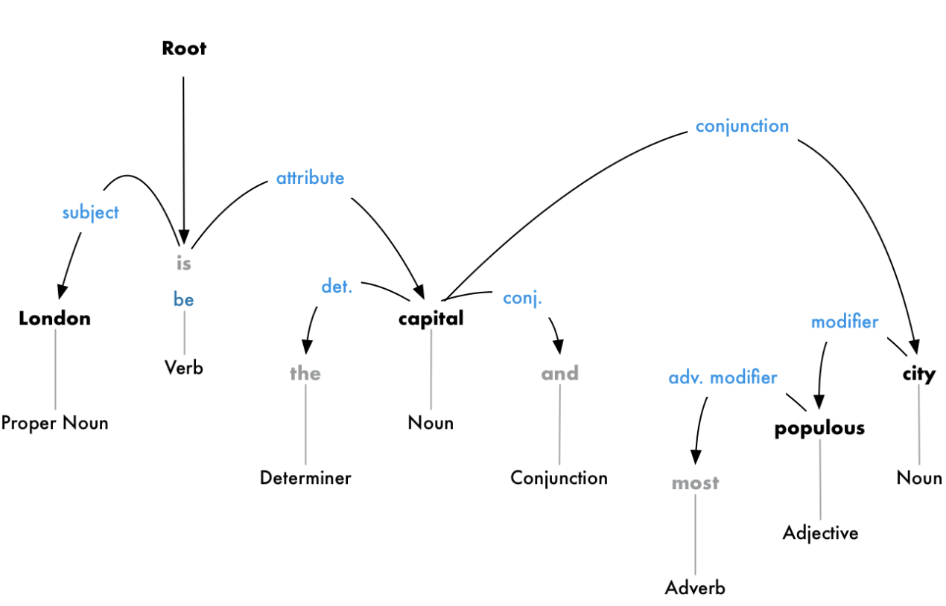
Dependency Parsing
Represents relations between words in a sentence
Build a tree that assigns a single parent word to each word in the sentence
Can also predict the relationship between two words
Leaves us with a graph-like structure where edge “weights” represent parts of speech and nodes can be both words and relations.

Slide 61

Named Entity Recognition
First real attempt to extract ideas!
Goal is to detect and label nouns with real-world concepts that they represent. Uses context and a statistical model to guess the type of noun a word represents.

Slide 62

Pipeline
Common design pattern in most NLP libraries
Need arises from the fact that we want to put together all the tools we just learnt
There is no “correct” ordering of the tools!

Slide 63
Intro to DL

Slide 64
Why do we care?
Thoughts?

Slide 65


Slide 66
Current Topic List
Advanced Regularization & Optimization
Hybrid Models
Time Series
Anomaly Detection
Intro to Deep Learning Networks
Convolutional Neural Networks
Recurrent Neural Networks & Applications to NLP
Generative Adversarial Networks
Project!

Slide 67
Checklist
Install Anaconda if you haven't already
Make sure Slack notifications are on
Make sure you know how to use web check-in
Reach out if you have any questions
Apply for Hacklytics: http://tiny.cc/hacklytics-apply
Come to kickoff! Same place, same time.

